Slide 1


HomeSecuriPi
A cheap security system for your house
Final Presentation
Authors:
Matteo Guerrini Giacomo Menchi William Paciaroni
Instructor:
J.T. Foley

Slide 2
Introduction
Problem: Detect strange movements and/or sounds inside a house or building
Why people care: People want to feel their home is protected
Requirements:
Cheap
Reliable
Easy to blend
Who wants it: Anyone who is owner of a house or building and would like to improve its security in a cheap way
Notes:
Reliable = (does not crash, avoid false positive and send ALARM message in less than 5 seconds)

Slide 3
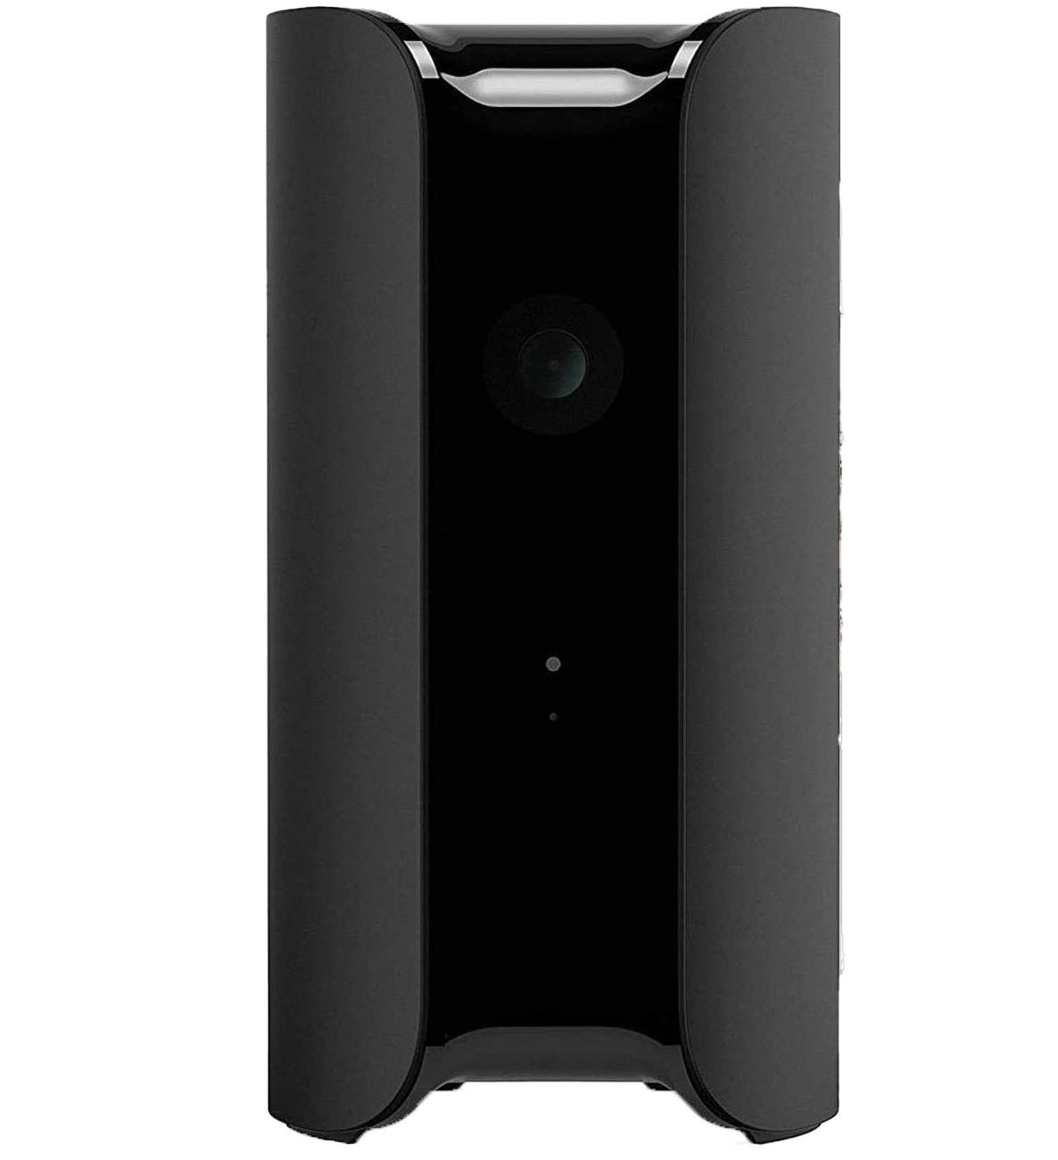
Related Works
Canary Camera: One of other solutions on the market. Its cost is of $99.00.
PROs
Weather condition monitoring
Real time camera
Past recordings
CONs
No movements detection
No alarm notification
High price for what it offers

Slide 4
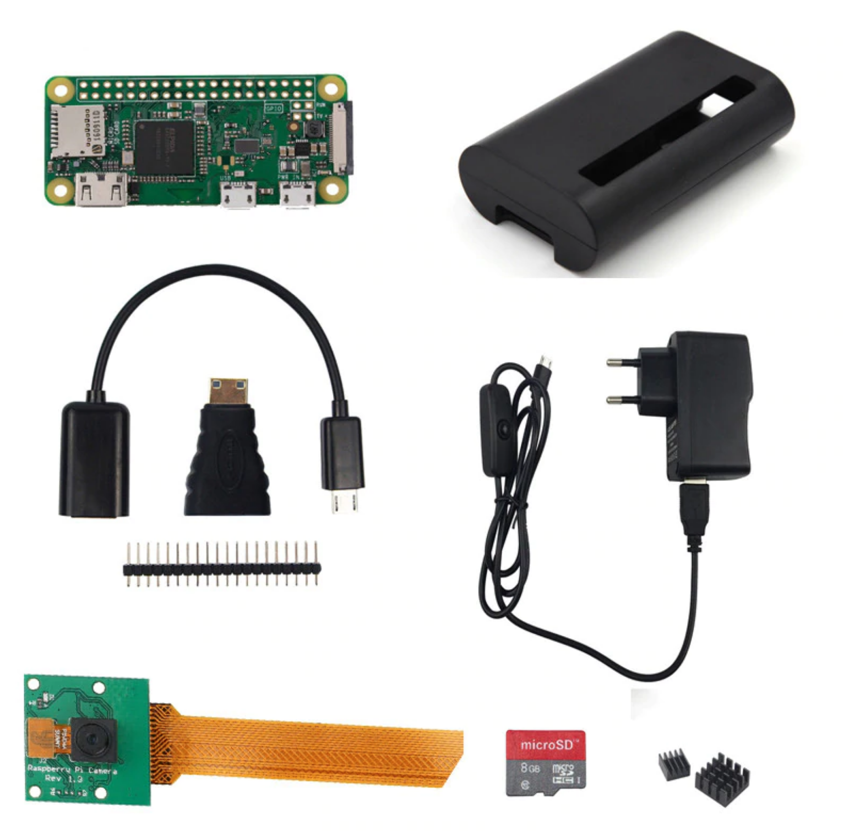
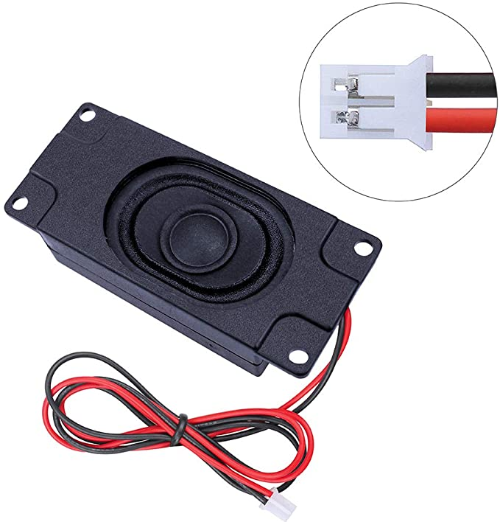
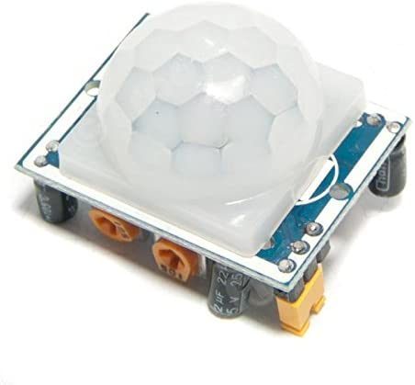
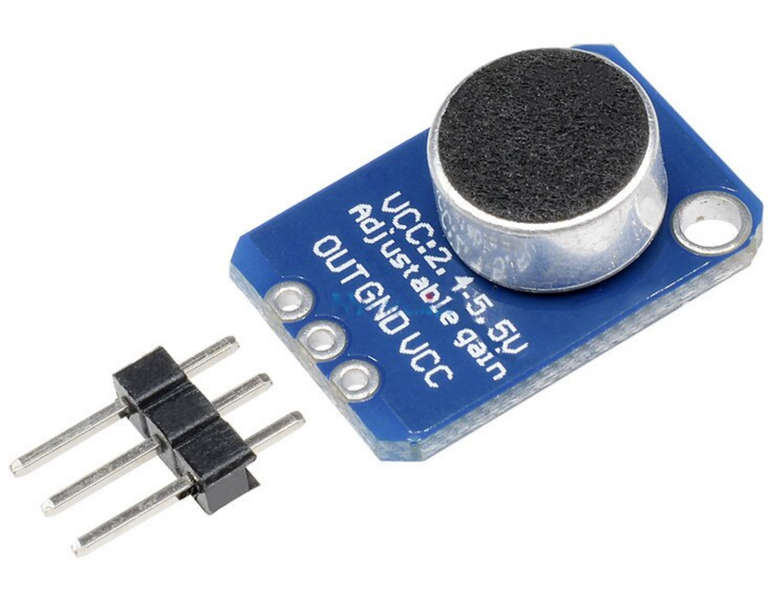
Hardware
PIR Sensor: $0.73
Speaker: $3.44
Starter Pack(RPi-Camera-SupplyPower): $29.66
Total: $34.79
MIC: $0.96

Slide 5
Software
Core: it is the heart of the program. It manages the TelegramBot. It enables/disables other scripts and controls speaker
Camera: it detects human movements and communicates to the Core
Mic: it detects loud noises, e.g. window shattering, and communicates to the Core
PIR: it detects presences and communicates to the Core
GitHub: https://github.com/ru-engineering/final-project-jst
Notes:
Core controls speaker in order to make sound when a movement or a sound is detected

Slide 6
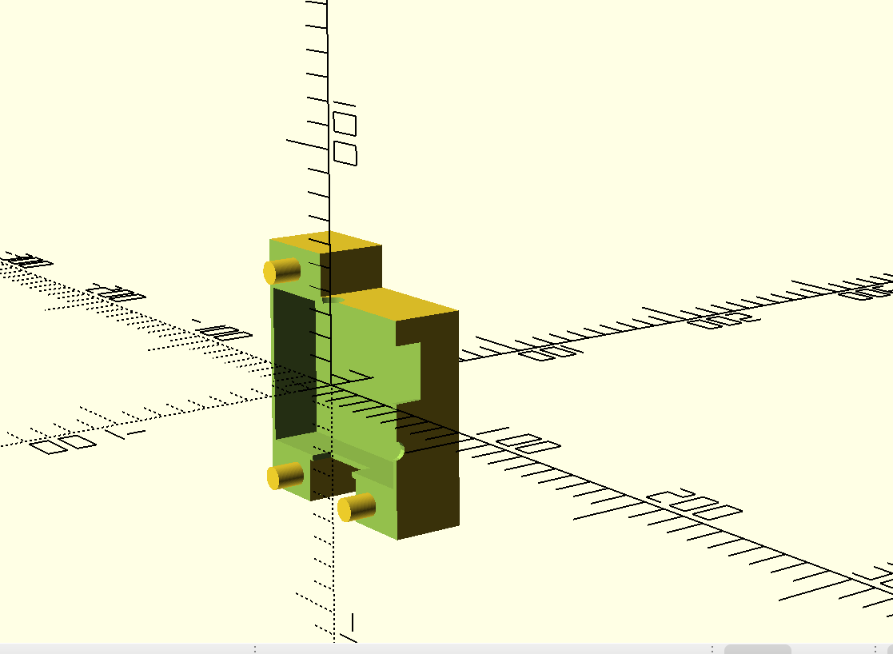
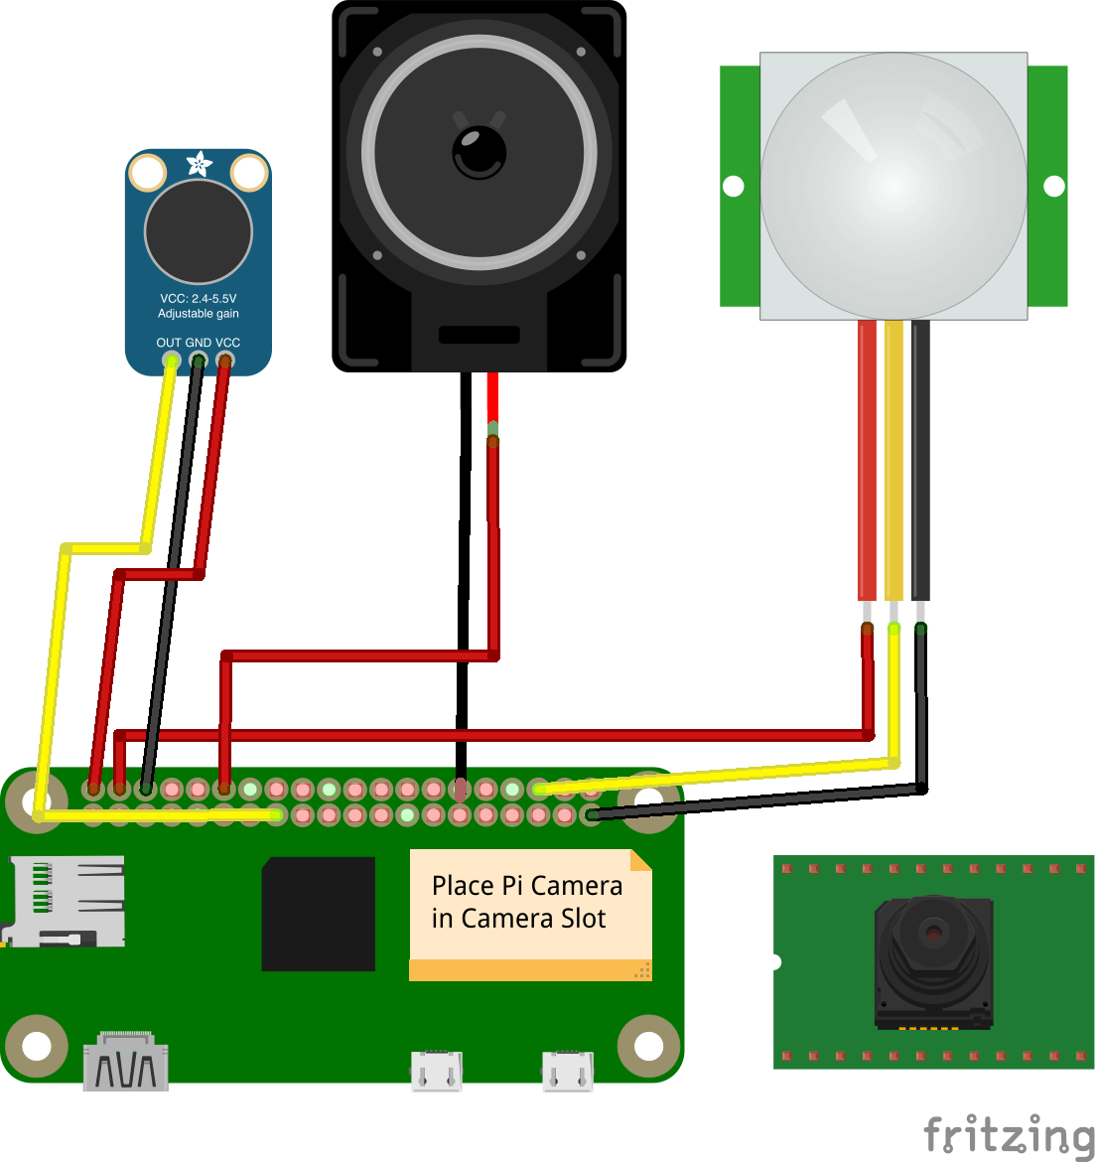
Model
Model: The model on the left is built using OpenSCAD and it is diveded in two different parts. Code is available on GitHub. The picture on the right, instead, is the schematic of the circuit.
Those could be useful to anyone who wants to replicate or improve our project.

Slide 7
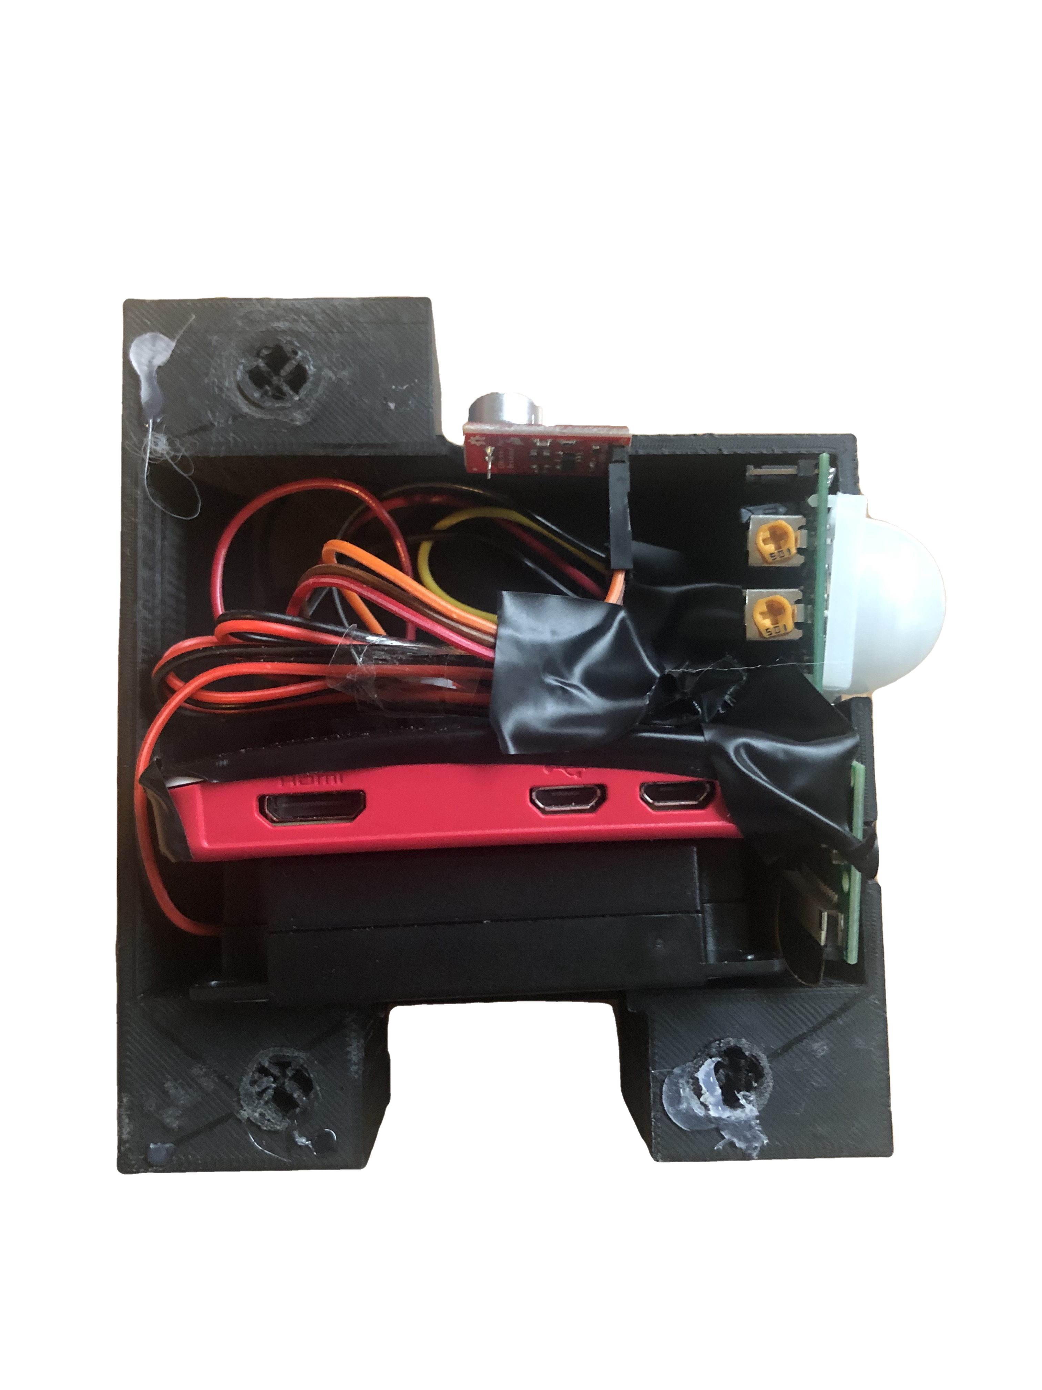
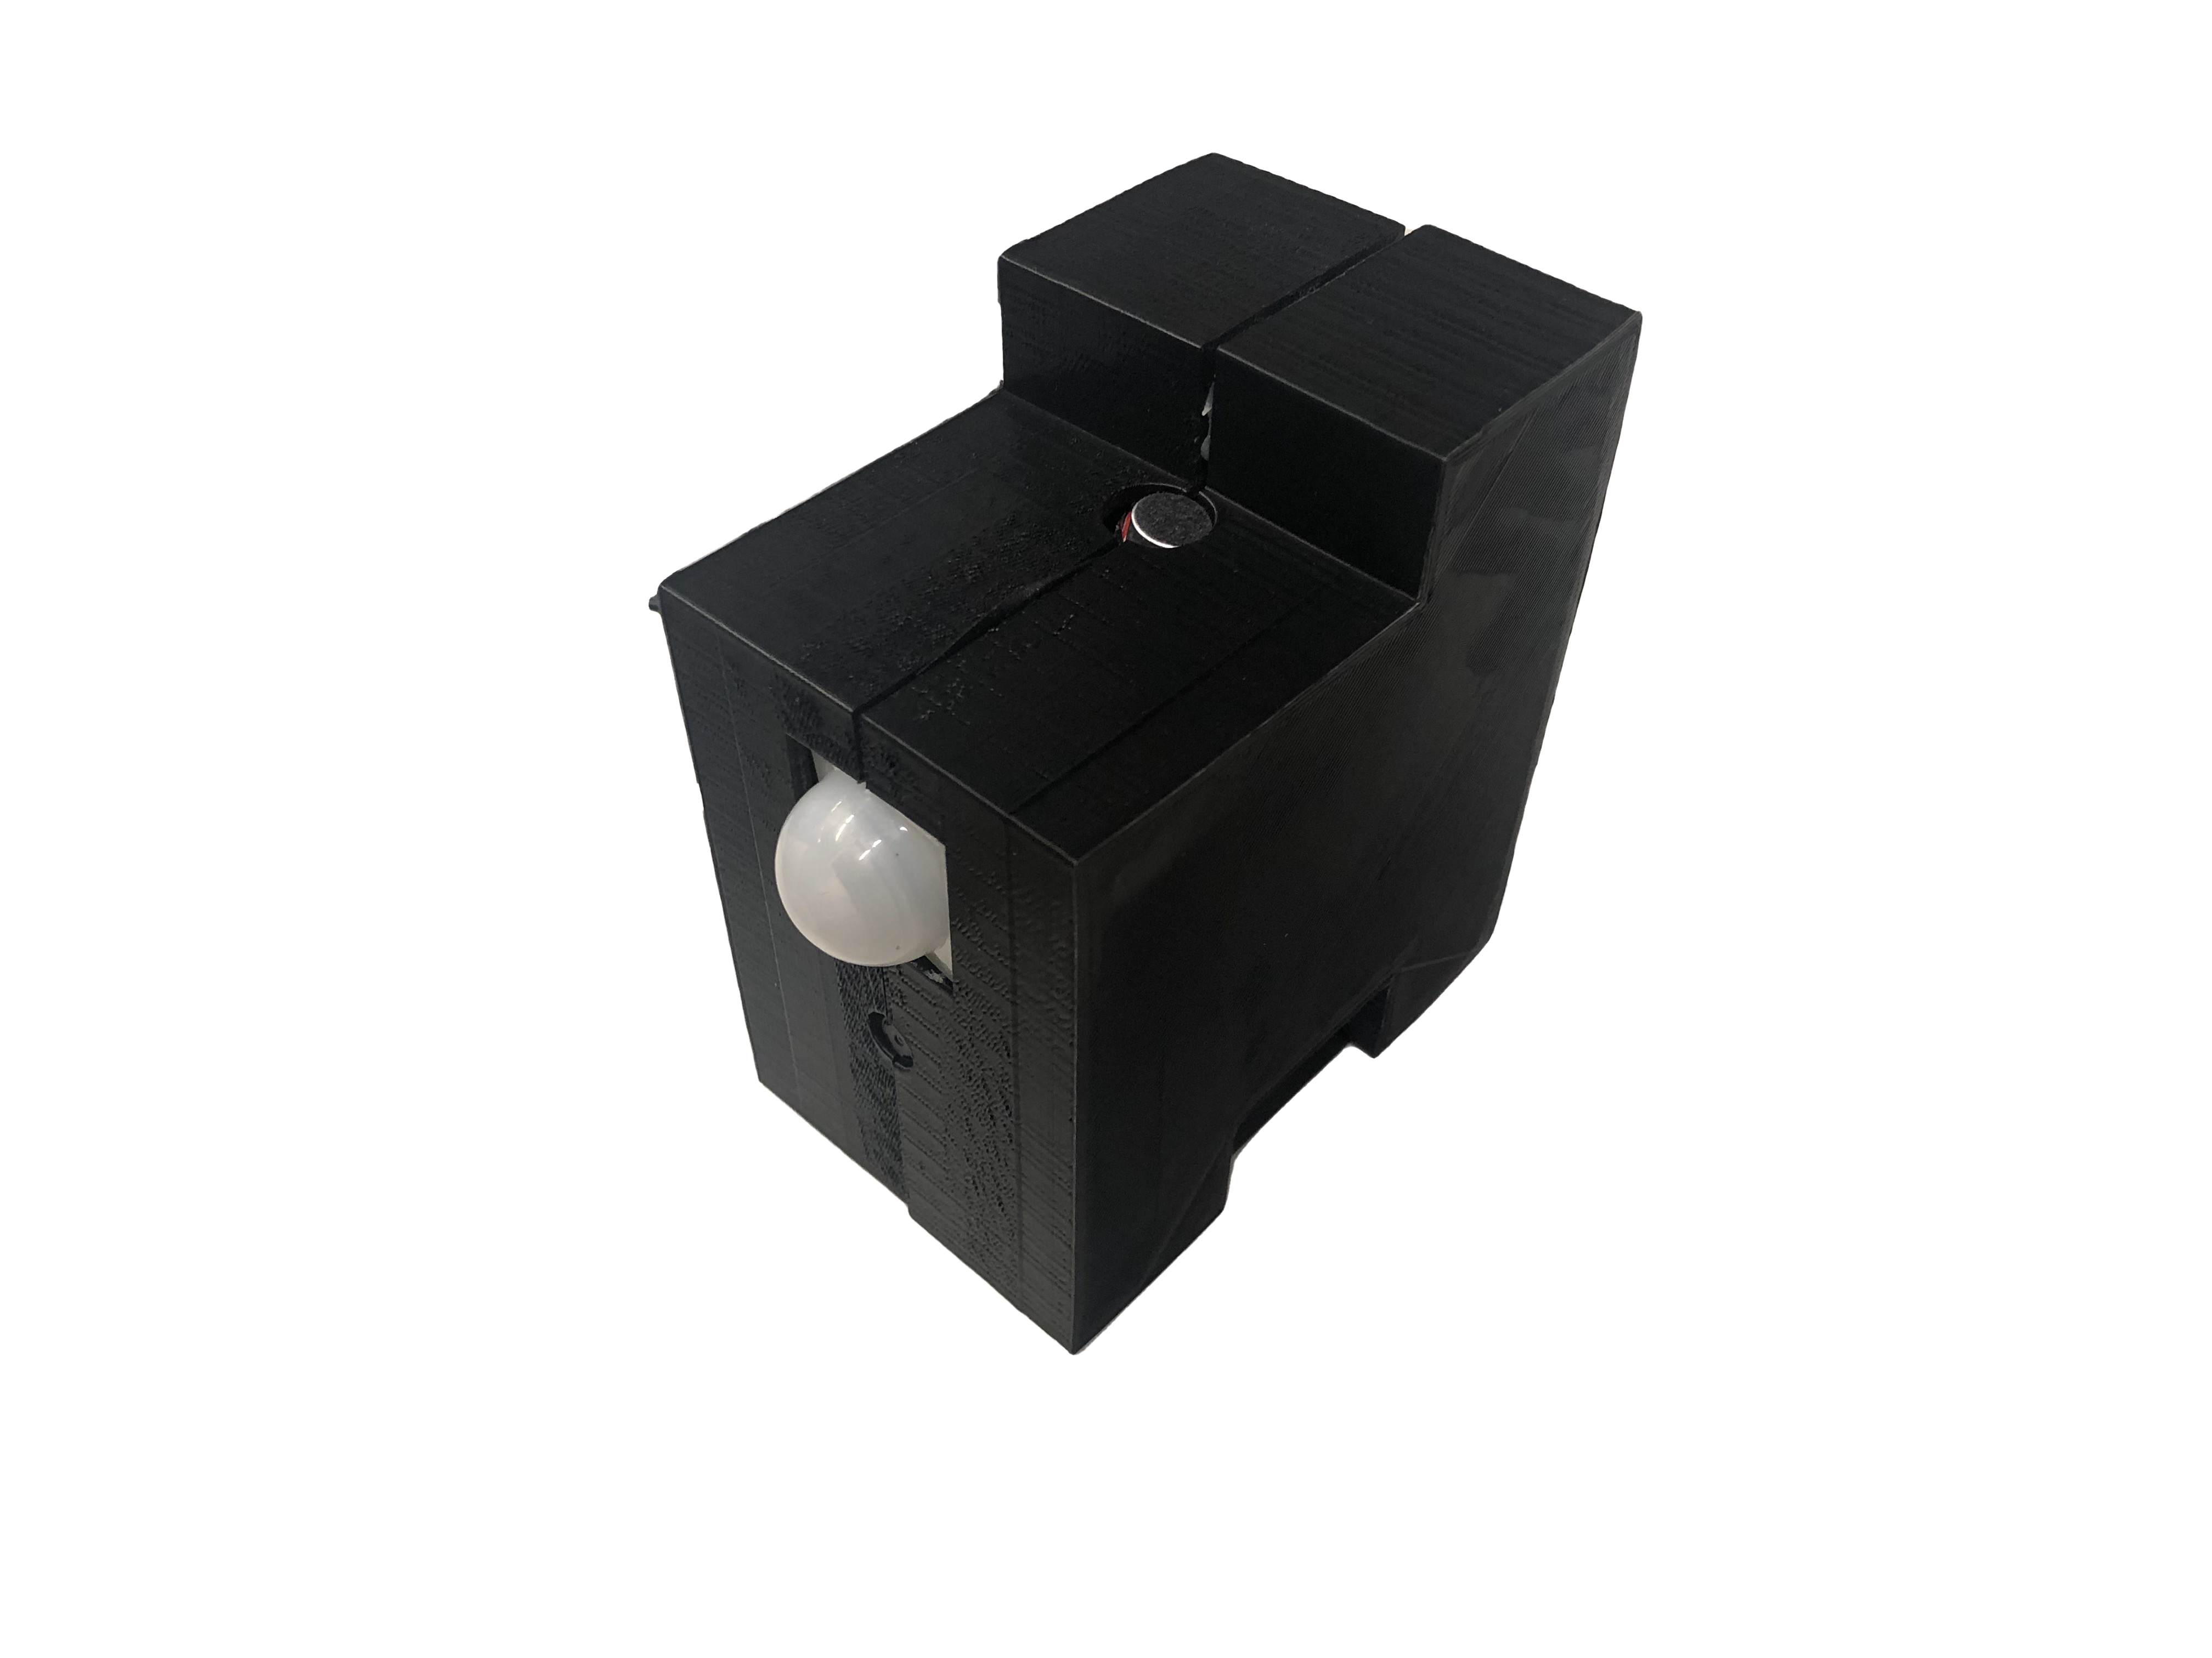
Design

Slide 8
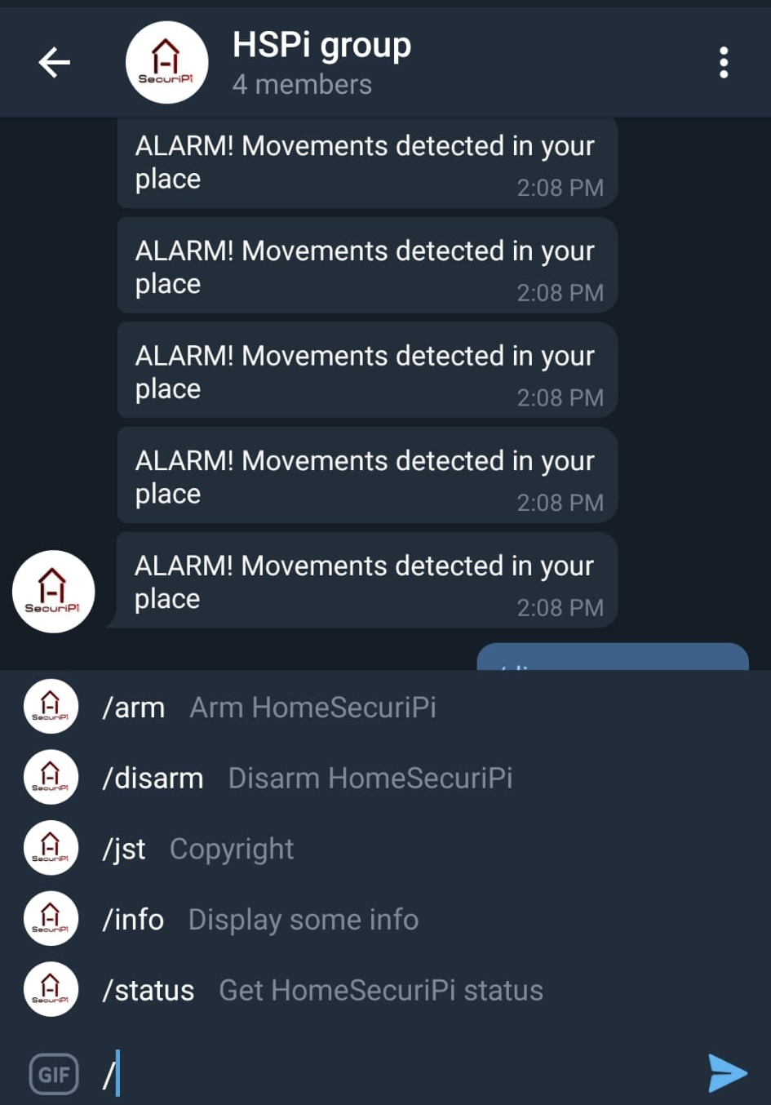
Current. Capabilities
Movement detection up to 50 meters, with no false positives
Sound detection over a certain threshold (58dB)
Scar off burglars using the integrated speaker
Notification via TelegramBot to a single person or a group
Dark design so that it blends with the environment, specially at night

Slide 9
Future Extensions
Use a more powerful RPi to have a more stable system with higher performance
Have a dedicated App to control it instead using the TelegramBot
Integrate with Amazon Alexa or similar
Live Video using the dedicated App
Capture photo on movement detection
Light sensor to check if lights are on

Slide 10
Conclusion
The bottom line is that we achieved a working home security system which detects movements and sounds, and communicates adequately with the user to signal them when something happens. The project is intended to be a prototype created in a short amount of time, and thus may present some flaws or other issues.
Nonetheless, we would like to thanks Reykjavik University which has given us the instruments and the possibility to develop this cool and useful project, in addition to the support during the development itself.

Slide 11
DEMO
Thank you for your attention!
And now a little demo of our project.

